Slide 1
Switches, Lights, and Multiplexers
FPGA Lab1

Slide 2
Lab1-PartI
The purpose of this exercise is to
Learn how to connect simple input and output devices to an FPGA chip and
Implement a circuit that uses these devices.

Slide 3
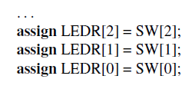
Switches and Lights
The DE10-Lite board provides ten switches and lights, called SW9−0 and LEDR9−0.
The figure below shows a single assignment statement for all LEDR outputs, which is equivalent to the individual assignments:

Slide 4
PIN Assignment
The DE-series boards have hardwired connections between its FPGA chip and the switches and lights.
To use the switches and lights it is necessary to include in your Quartus® project the correct pin assignments, which are given in your board’s user manual.

Slide 5
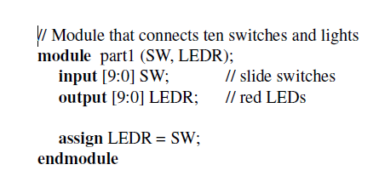
Verilog code - ten switches and lights

Slide 6
Design Implementation Steps
Create a new Quartus project for your circuit. Select the target chip that corresponds to your DE-series board.
Create a Verilog module for the code in the previous slide and include it in your project.
Include the required pin assignments for your DE-series board in your project, as discussed above. Compile the project.
4. Download the compiled circuit into the FPGA chip by using the Quartus Programmer tool.
5. Test the functionality of the circuit by toggling the switches and observing the LEDs.

Slide 7
Quartus Demo

Slide 8
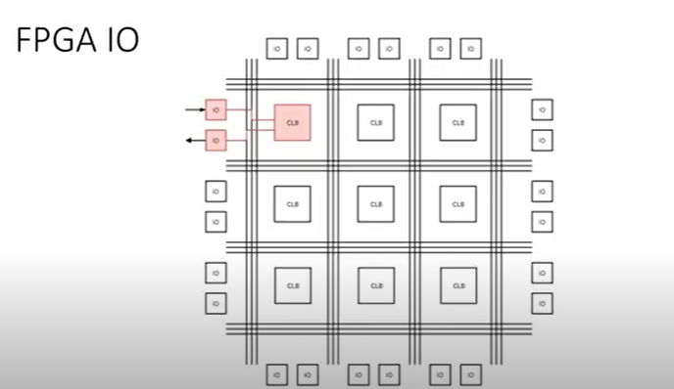

Slide 9
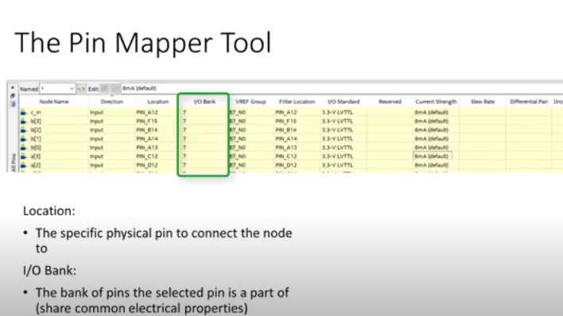

Slide 10
Lab#1 – Part II
The purpose of this exercise is to learn how to implement a 2-to-1 multiplexer with a select input s.

Slide 11
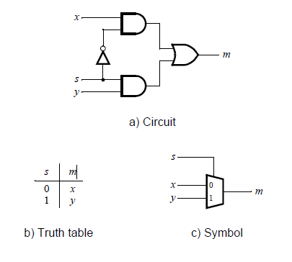
2-to-1 MUX
If s = 0 the multiplexer’s output m is equal to the input x, and if s = 1 the output is equal to y.

Slide 12
The multiplexer can be described by the following Verilog statement:
assign m = (∼s & x) | (s & y);

Slide 13
Perform the steps listed below
1. Create a new Quartus project for your circuit.
2. Include your Verilog file for the four-bit wide 2-to-1 multiplexer in your project.
3. Use switch SW9 as the s input, switches SW0 as the X input and SW2 as the Y input.
4. Display the value of the output M to LEDR9, and connect the unused LEDR lights to the constant value 0.
5. Include in your project the required pin assignments for your DE-series board
6. Compile the project, and then download the resulting circuit into the FPGA chip. Test the functionality of the 2-to-1 multiplexer by toggling the switches and observing the LEDs.

Slide 14
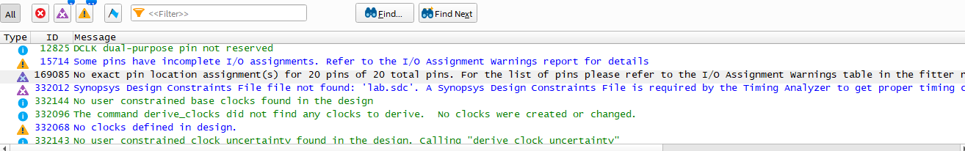

Slide 15
Assignment-Perform the steps listed below
1. Create a new Quartus project for your circuit.
2. Include your Verilog file for the four-bit wide 2-to-1 multiplexer in your project.
3. Use switch SW9 as the s input, switches SW3−0 as the X input and SW7−4 as the Y input.
4. Display the value of the input s on LEDR9, connect the output M to LEDR3−0, and connect the unused LEDR lights to the constant value 0.
3. Include in your project the required pin assignments for your DE-series board. As discussed in Part I, these assignments ensure that the ports of your Verilog code will use the pins on the FPGA chip that are connected to the SW switches and LEDR lights.
4. Compile the project, and then download the resulting circuit into the FPGA chip. Test the functionality of the four-bit wide 2-to-1 multiplexer by toggling the switches and observing the LEDs.

Slide 16
Lab#2 – Part III
The purpose of this exercise is to display on the 7-segment displays HEX1 and HEX0 the values set by the switches SW7−0.
Let the values denoted by SW7−4 and SW3−0 be displayed on HEX1 and HEX0, respectively. Your circuit should be able to display the digits from 0 to 9, and should treat the valuations 1010 to 1111 as don’t-cares.

Slide 17
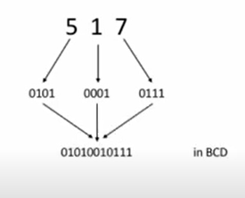
BCD

Slide 18
